Slide 1
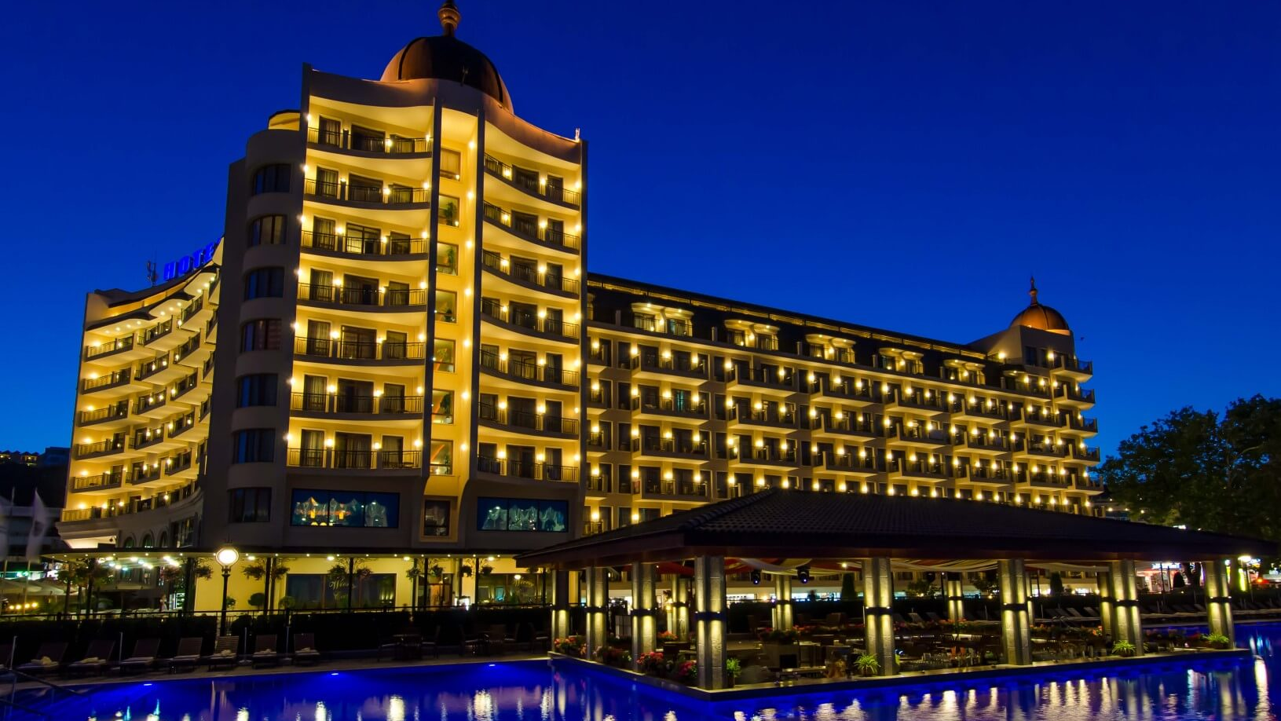
HOTEL MANAGEMENT SYSTEM

Slide 2

AGENDA:
INTRODUCTION
PROJECT PROPOSAL
REQUIREMENT ANALYSIS
PERSONAS
SCHEDULE
RETROSPECTIVE

Slide 3
INTRODUCTION

Slide 4
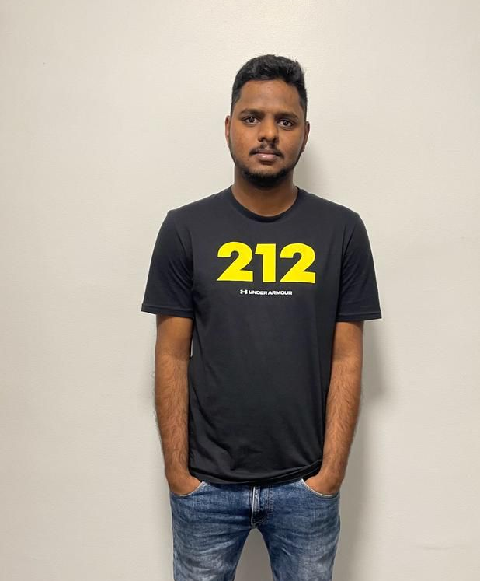
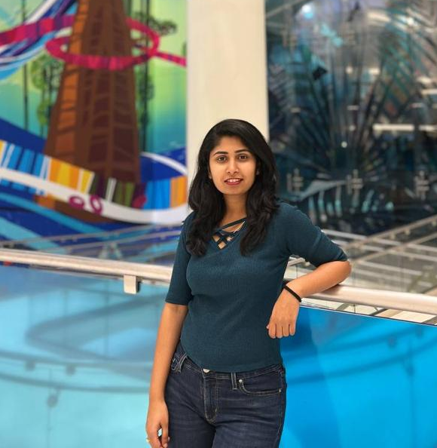
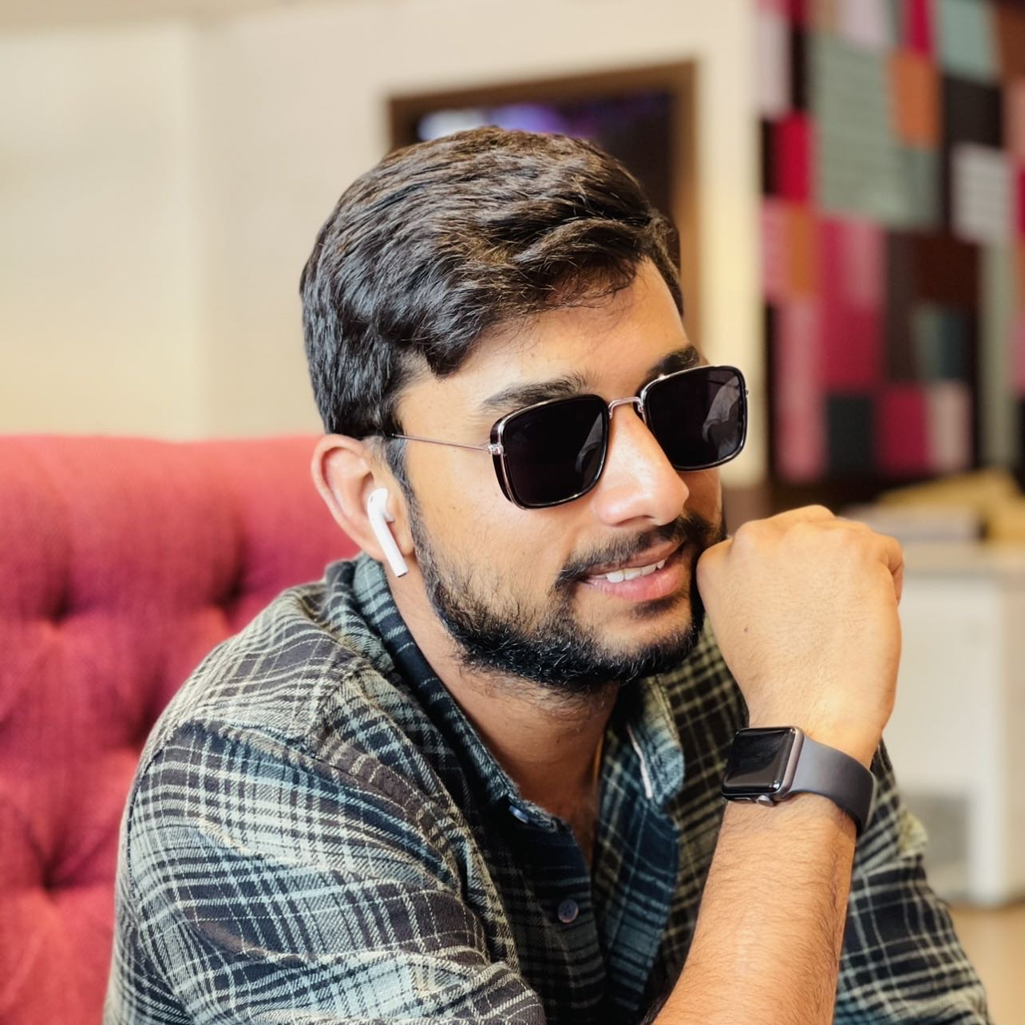
SATHWIK MUDENTI
BACKEND DEVELOPER
BRUNDA REDDY
DATABASE ADMINISTRATOR.
VARUN REDDY DUGGIMPIDI BACKEND DEVELOPER 2

Slide 5

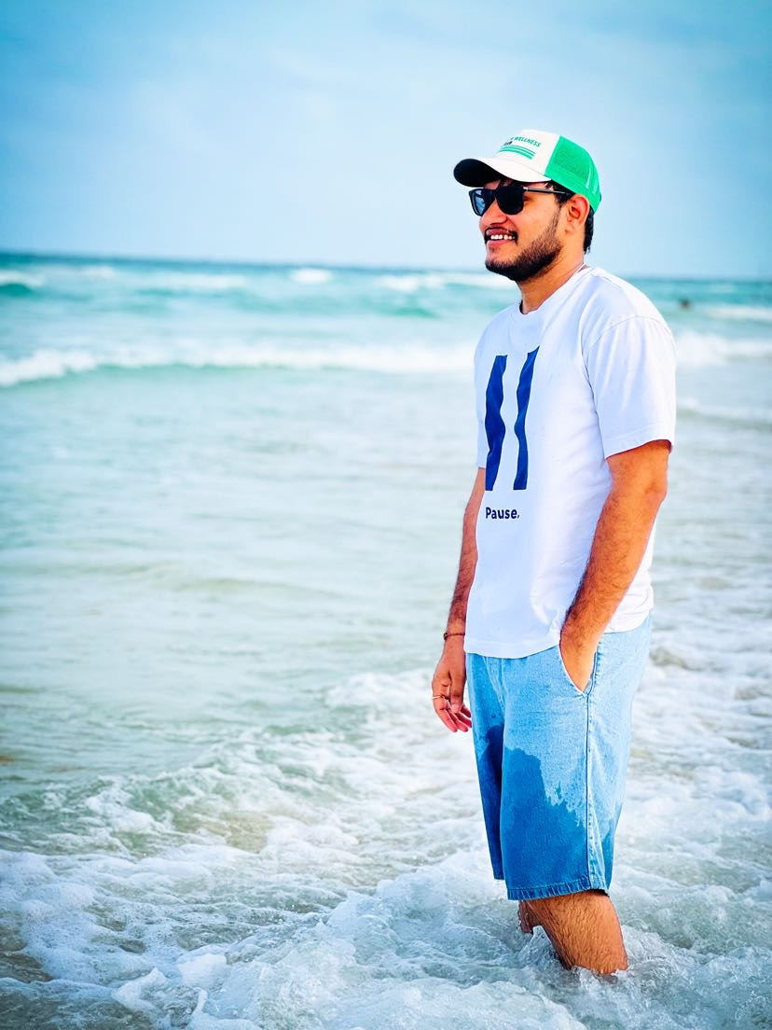
MAANASA DHARINI
FRONTEND DEVELOPER.
CHINTA NARESH BABU
QA/TESTER

Slide 6
PROJECT PROPOSAL

Slide 7
To develop a Web-application that reduces grunt work.
To help restaurant owner & mangers to run the business end-to-end.
Keep track of inventory orders, reservations, billing, employees and payroll.
System needs the security of data so that the transactions will be confidential.

Slide 8
REQUIREMENT
ANALYSIS

Slide 9
Hotel Management System is a web-based application.
Html, CSS, Js are used to develop UI and backend of the application is developed using Php.
MySql is used as a database for this project.

Slide 10
SCHEDULE

Slide 11
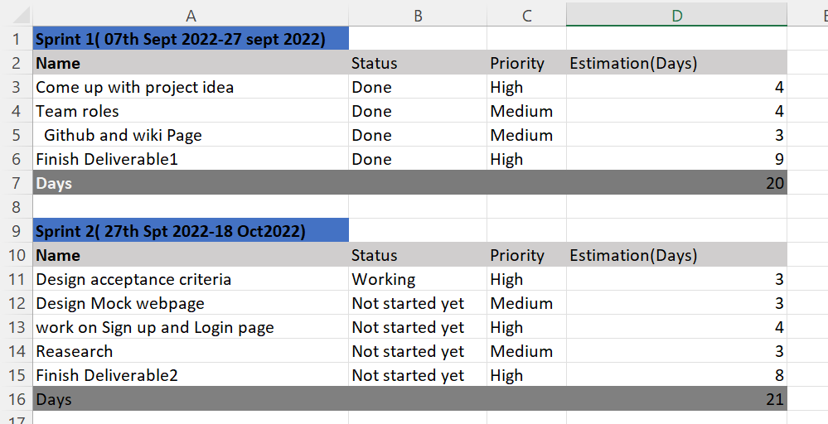

Slide 12
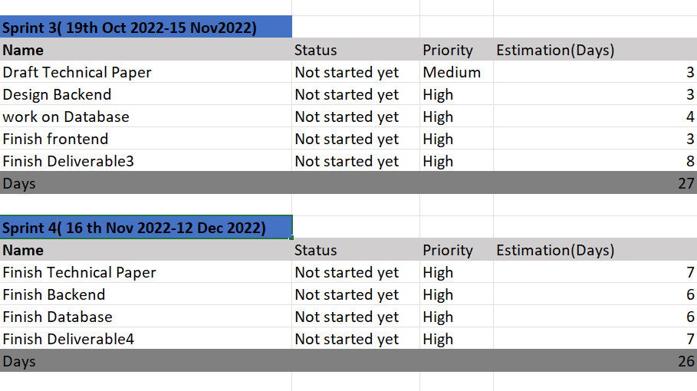

Slide 13
Team Contract

Slide 14
Openness:
To be effective, open sharing with group members is essential to success.
Trust:
It is essential that members trust each others and that is built through honest and open communications.
Conflicts:
A firm agreement should be reached on how decisions triaged and how differences will be settled.

Slide 15
Tolerance:
There are no “perfect” so be tolerant and do not make judgements about others in the team.
Feedback:
Team members offer and receive constructive feedback from each other on their ideas, leadership.
Challenges:
Challenges by others considered to be healthy, if expresses in a respectful manner which individuals do not engage in personal attacks.

Slide 16

PERSONAS

Slide 17
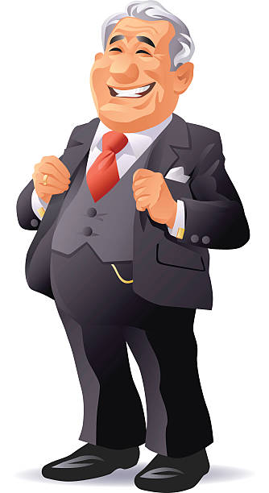
Founder
Mr. George​​- A 60 years old Businessman who owns group of luxury hotels in United States.
He is raised in the family business.
He developed an early passion for hospitality.
In his more than 40 years at the company’s helm, he built his hotels into a global lodging companies with more than 400 employees spanning 3 states.

Slide 18

CEO
Mr. Michael is the CEO and owns stakes in the group of the hotels​.
He is 35 years old, constantly looking for ways to streamline his business.
He is committed to create a sustainable future for his company.

Slide 19

Manager
Miss Amy is the manager who handles 70 employees in one of the hotels.
She is 25 years old, young, smart and very committed to her work.
She makes sure that her team is aligned all times.
She co-operates with multiple departments and communicates with the customers.

Slide 20
RETROSPECTIVE

Slide 21
What went well??
Meetings were scheduled at regular intervals and all the members of the team contributed well.
Tasks were shared between individuals to collect the regular background information.
We finalized the technologies that are going to be included in the project.

Slide 22
What needs to be improved??
More research on the technologies that we finalized needs to done.
Staying committed to the deadlines and work accordingly.

Slide 23
THANK YOU

